Slide 1

How to Really Use
Grammarly

Slide 2
What is Grammarly?

Slide 3
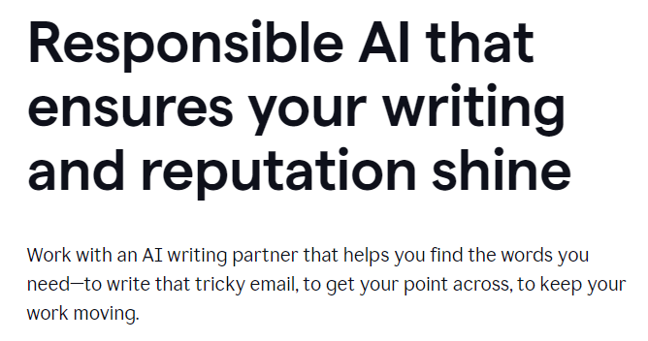
Notes:
https://www.grammarly.com/

Slide 4
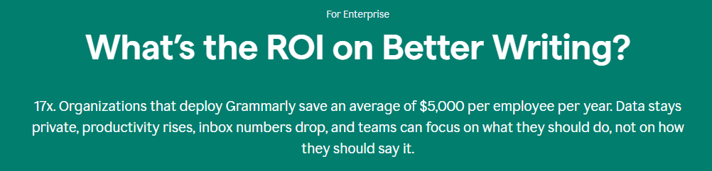
Notes:
https://www.grammarly.com/

Slide 5
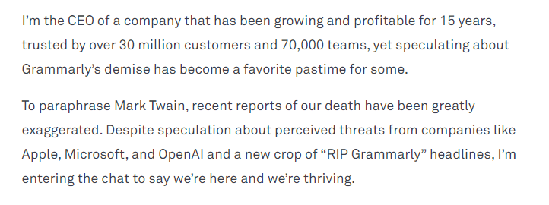
Notes:
https://www.grammarly.com/blog/future-communication-ai/

Slide 6
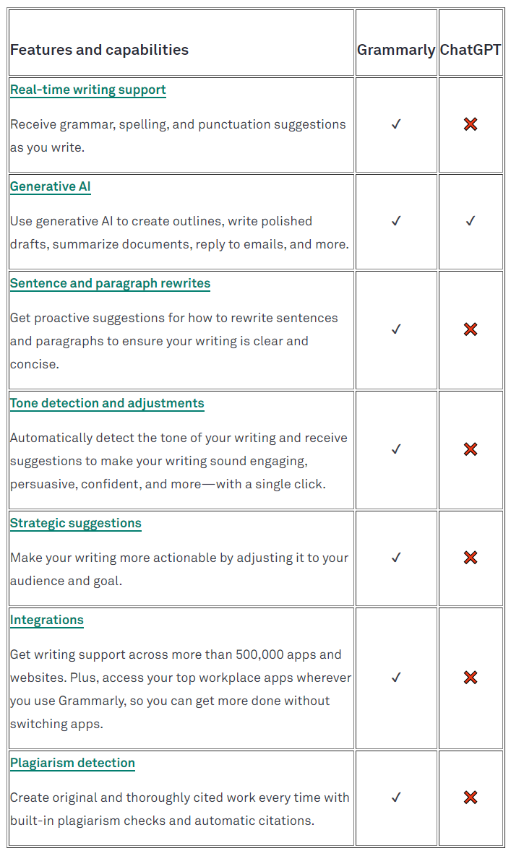
Notes:
https://www.grammarly.com/blog/grammarly-vs-chatgpt/

Slide 7

Pricing
Notes:
https://www.grammarly.com/plans

Slide 8
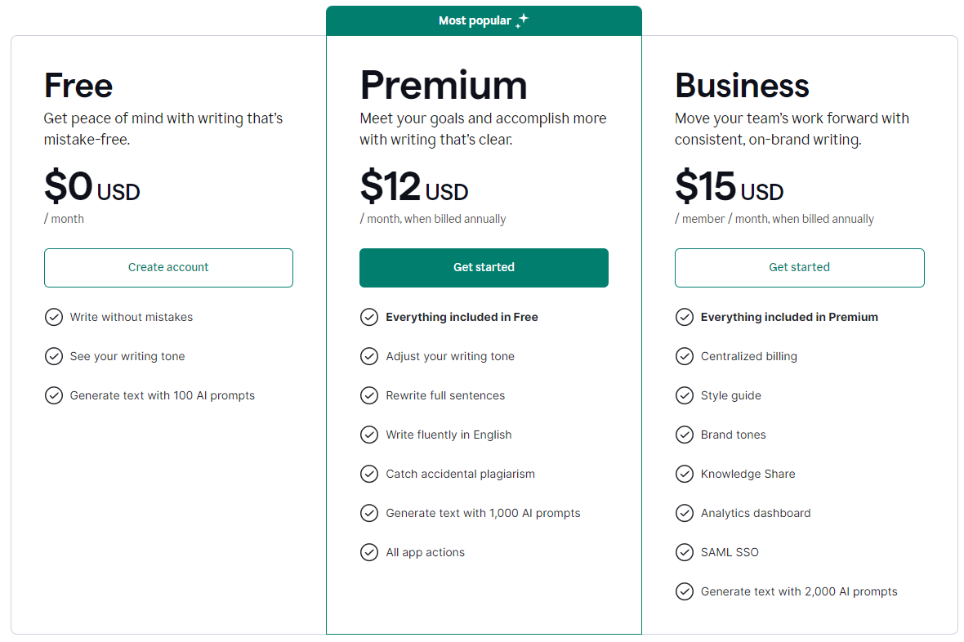

Slide 9
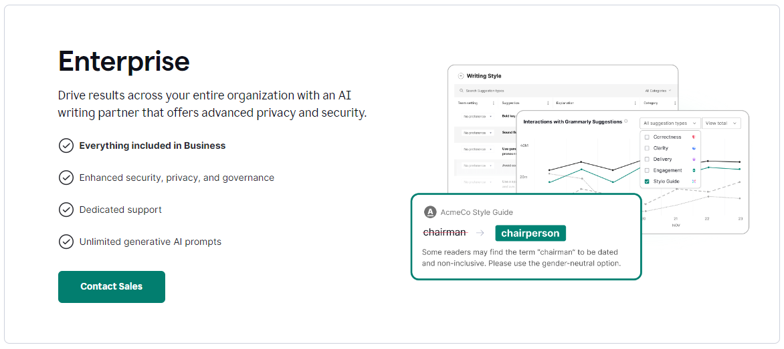

Slide 10

features
Notes:
https://www.grammarly.com/plans

Slide 11
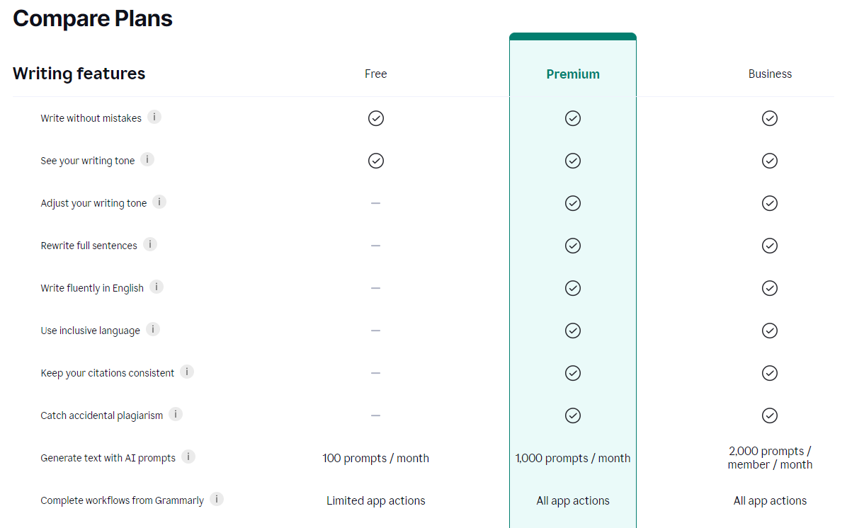

Slide 12
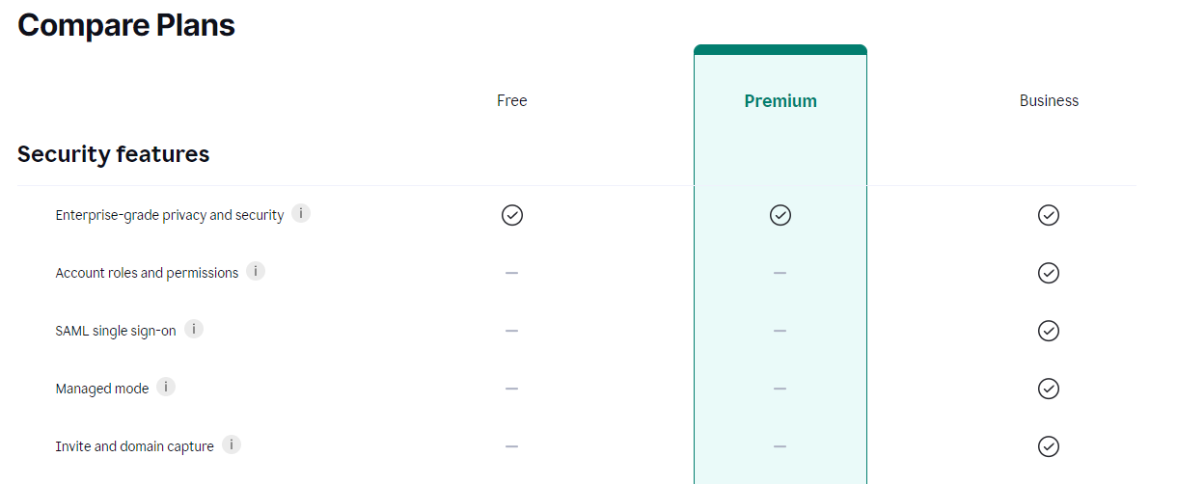

Slide 13
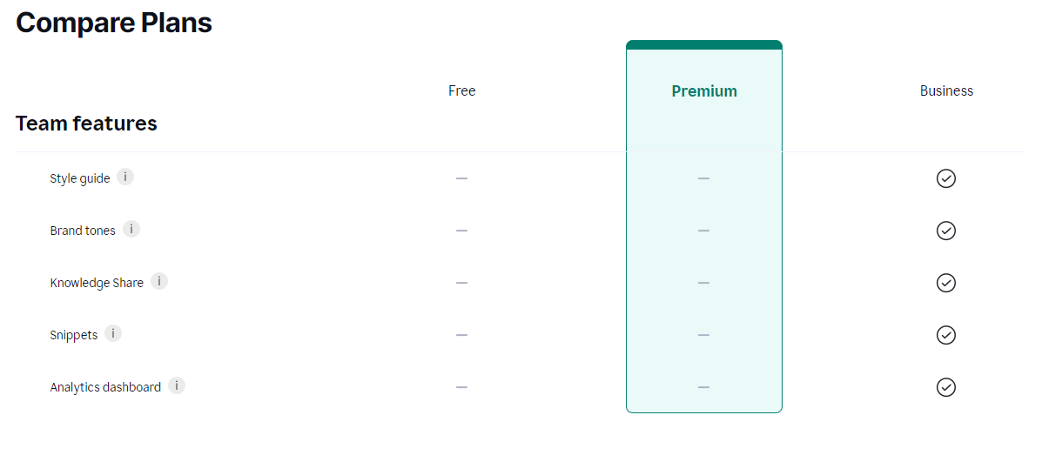

Slide 14

Signing Up

Slide 15
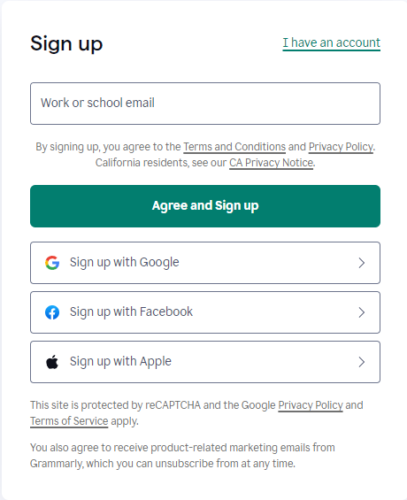
Free or premium account

Slide 16
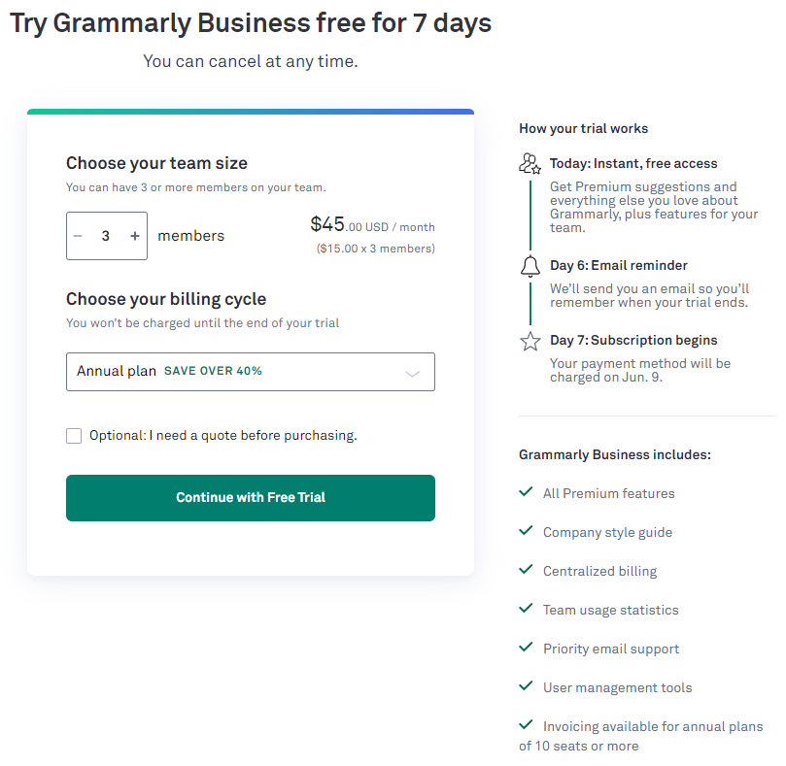
Business account (annual)

Slide 17
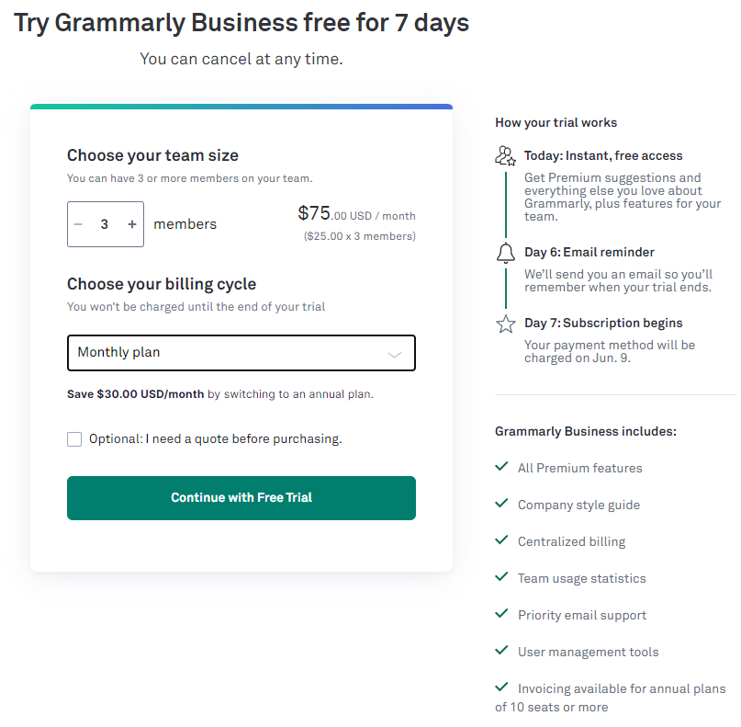
Business account (monthly)

Slide 18




Notes:
https://www.youtube.com/channel/UC35ZpwldGw7ZJ5R-2sLijzw

Slide 19
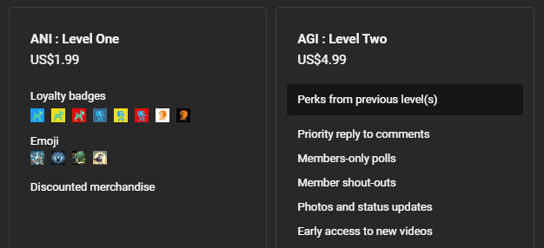
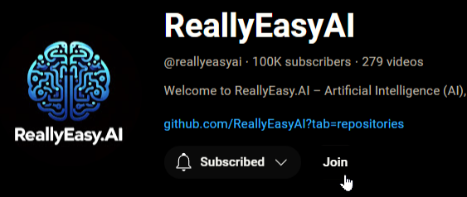
Membership has its privileges
Notes:
https://www.youtube.com/channel/UC35ZpwldGw7ZJ5R-2sLijzw/join

Slide 20

Install options

Slide 21
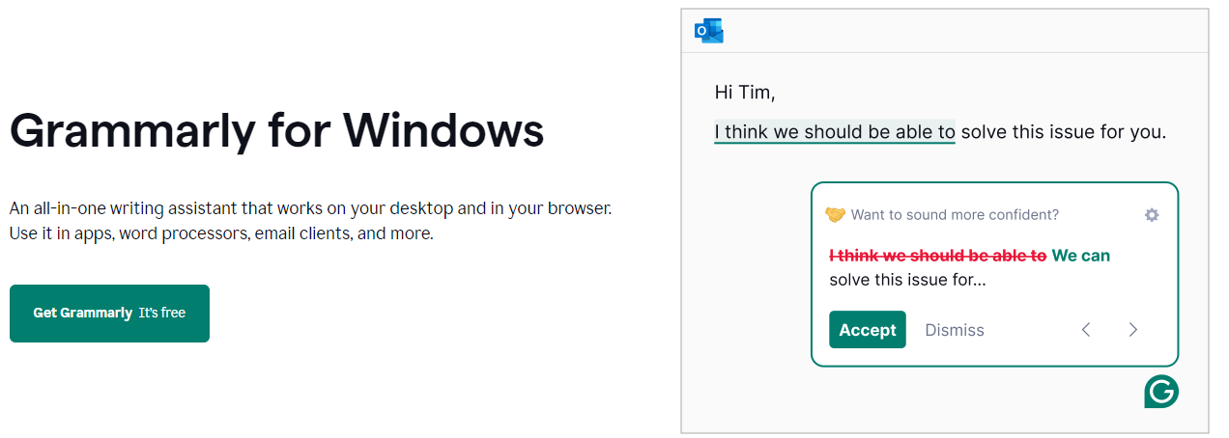
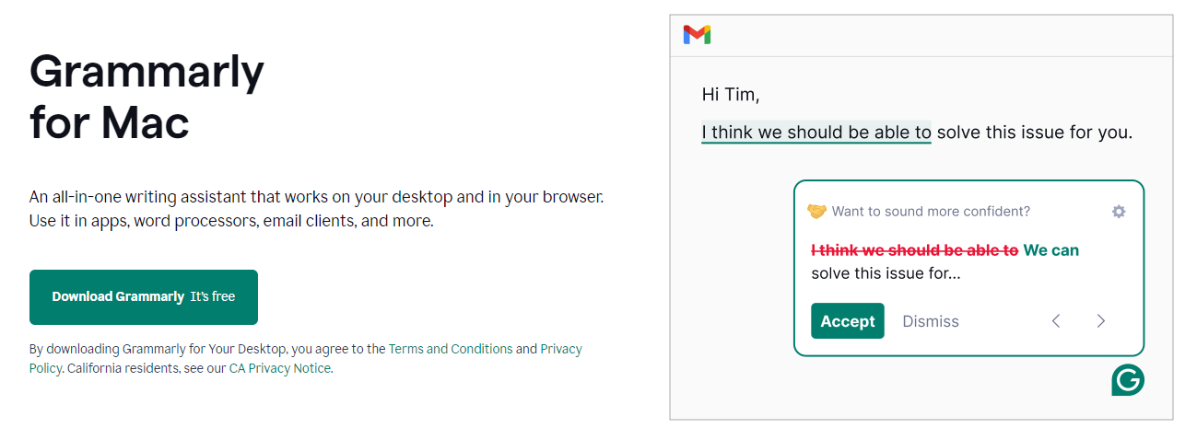
desktop

Slide 22
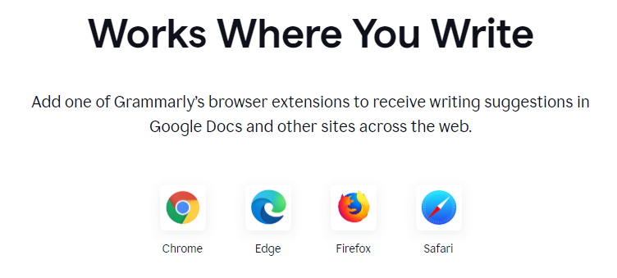
Browsers

Slide 23
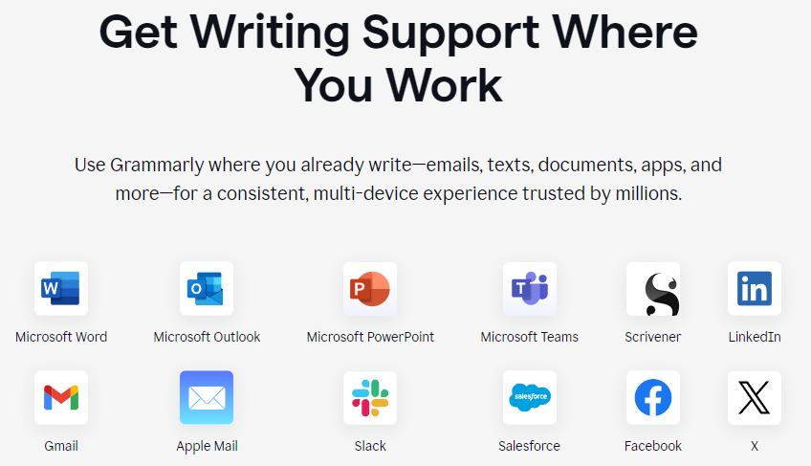
Productivity

Slide 24
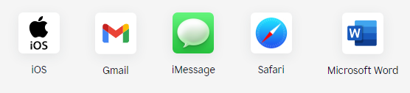
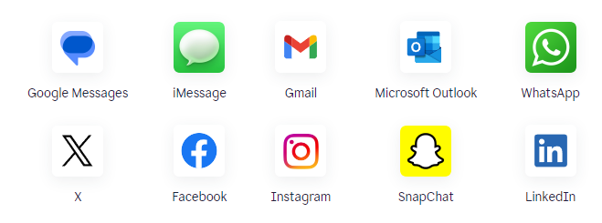
Mobile – iPhone, iPad, and android

Slide 25


